Slide 1
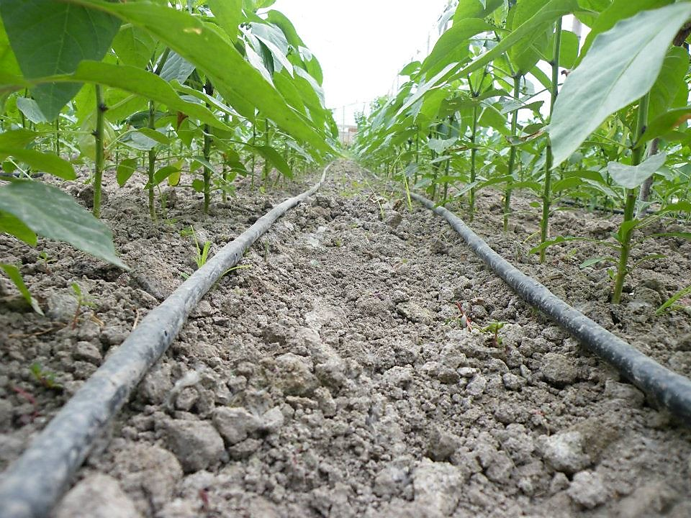
AUTOMATIC PLANT IRRIGATION
SYSTEM USING IC555
This Photo by Unknown Author is licensed under CC BY-SA-NC

Slide 2
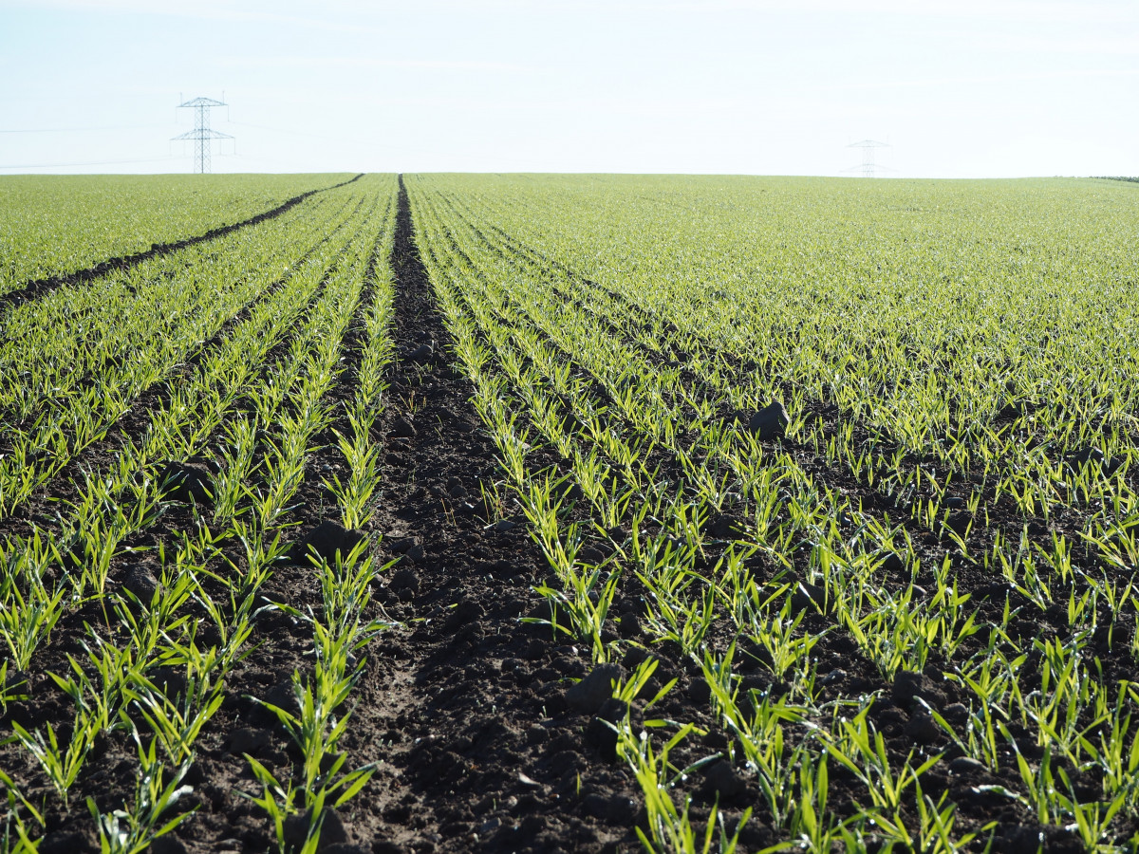
OBJECTIVE:
The main objective of the project is to ensure plants receive the right amount of water. By continuously measuring the moisture levels in the soil, the system automatically waters the plants only when needed. This helps prevent overwatering or underwatering, conserves water, and promotes healthy plant growth. Essentially, it makes plant care easier and more efficient by managing irrigation based on real-time soil conditions.

Slide 3
INTRODUCTION:
An automatic plant irrigation system using an IC 555 timer provides an efficient way to keep plants watered without constant manual intervention. This system starts with a soil moisture sensor that detects how wet or dry the soil is. When the soil becomes too dry, the sensor sends a signal to the IC 555 timer. The IC 555, acting as a timer, processes this signal to control a water pump. Depending on its configuration, the IC 555 can either turn the pump on and off at set intervals or for a specific duration, ensuring that the plants receive the right amount of water. This setup automates the watering process, making plant care simpler and more consistent.

Slide 4
APPARATUS REQUIRED:
1. SOIL MOISTURE SENSOR 5V
2. IC NE555
3. CAPACITOR-100μF
4. RELAY 5V
5. RESISTOR- 10Ω, 2Ω
6. DC MOTOR -3V-48V
7. WATER PUMP-12v DC
8. VOLTAGE REGULATOR-LM317
9. ADAPTER-100-240 v AC

Slide 5
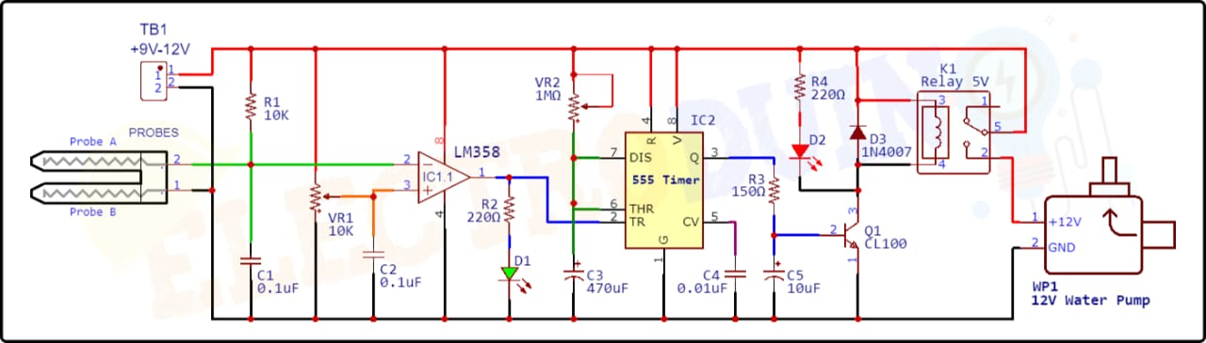
CIRCUIT DIAGRAM:

Slide 6
PROJECT EXPLANATION:
An automatic plant moisture system is like a smart helper for your garden. It has a sensor that checks how wet or dry the soil . If the soil gets too dry, the system will automatically turn on a water supply to give your plants just the right amount of water. This way, your plants get the moisture they need without you having to do it manually. It helps keep your plants healthy and saves You time! This system also helps conserve water by only using it when necessary, making it environmentally friendly. Additionally, it can be programmed to water plants on a schedule, making it ideal for busy people or those who travel often. Overall, it simplifies plant care, reduces water waste, and supports optimal plant health.

Slide 7
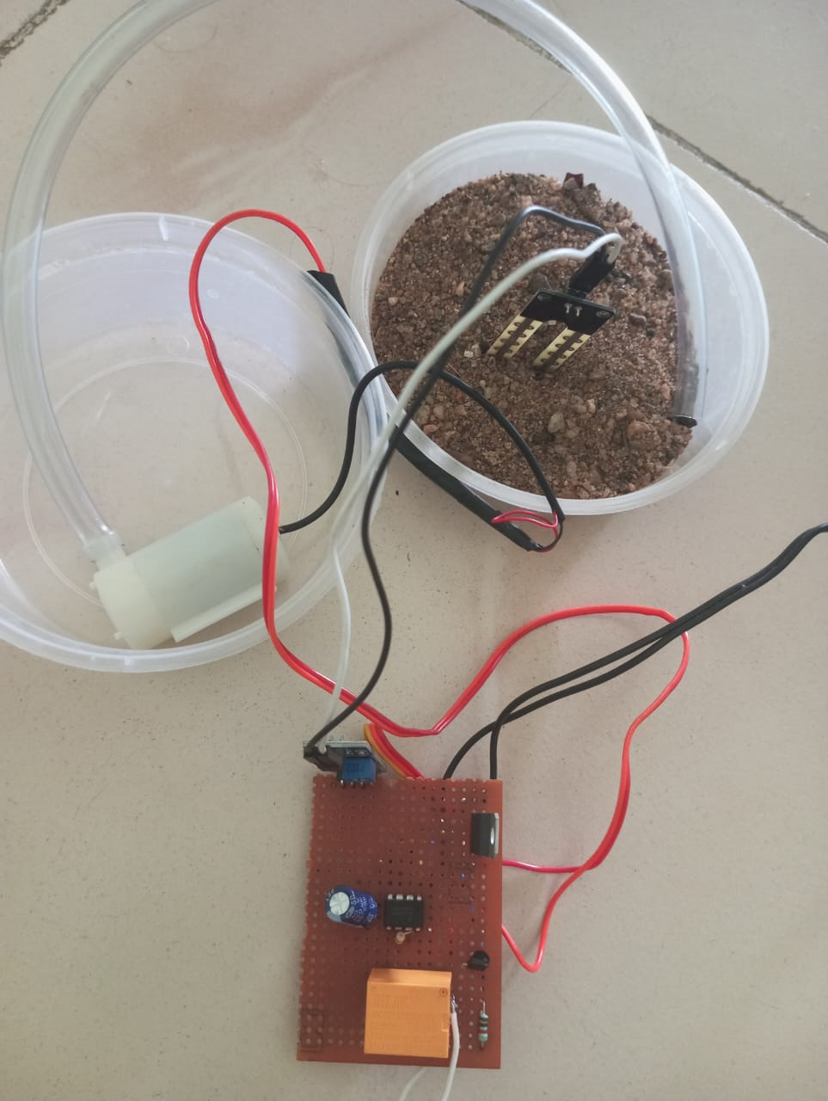
RESULT:

Slide 8
RESULT AND DISCUSSION:
Results: The automatic plant irrigation system using the IC 555 timer successfully operated to water plants based on soil moisture levels. The soil moisture sensor detected dryness and triggered the IC 555 timer, which generated pulses to activate a relay. The relay then powered the water pump for a set duration, providing water to the plant. Once the soil reached the desired moisture level, the system stopped the pump automatically.
Discussion: The system was cost-effective, simple, and reliable. The IC 555 timer’s low cost and straightforward operation made it an ideal choice for controlling the irrigation process. However, the system’s flexibility was limited; it lacked advanced scheduling and customization options that could be provided by more complex microcontroller-based systems. The sensor’s calibration was crucial for accurate moisture detection, and the system worked best for small-scale, single-plant applications. For larger-scale irrigation or more advanced features, improvements like solar power integration, microcontroller use, or wireless control would enhance the system’s performance.

Slide 9
APPLICATION:
➢Home Gardening: Automates watering of indoor or outdoor plants, ensuring they receive adequate water even when the owner is away or busy.
➢Greenhouses: Maintains consistent soil moisture levels in greenhouse environments, promoting healthy plant growth and reducing the need for manual watering.
➢Agriculture: Can be used for small-scale farms or vegetable gardens, providing efficient irrigation while conserving water.
➢Parks and Landscapes: Used for watering lawns, flower beds, and landscaped areas in parks or public gardens, optimizing water usage.
➢Urban Farming: Suitable for urban gardens or rooftop farms, automating irrigation in areas where regular maintenance might be challenging.

Slide 10
FUTURE PLAN:
The future of automatic plant irrigation systems lies in advanced AI integration, IoT connectivity, and smart sensors. These systems will adapt to real-time weather data, soil conditions, and plant types. Powered by renewable energy, they will ensure water efficiency, reduce manual effort, and support sustainable agriculture in both urban and rural settings.

Slide 11
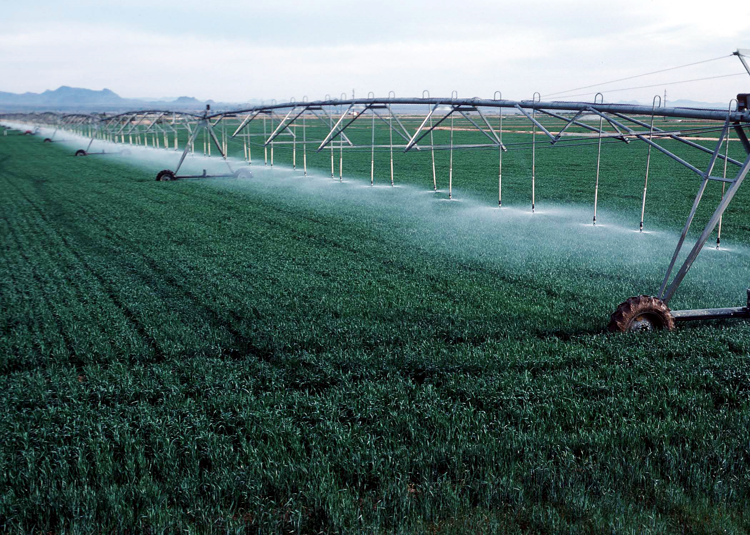
THANK YOU!!
DEEPIKA S(927623BEC023)
CHANDIKA K(927623BEC020)
DHARANI S(927623BEC029)
AKSHAYA N S(927623BEC006)

